Slide 1
Module 14

Slide 2
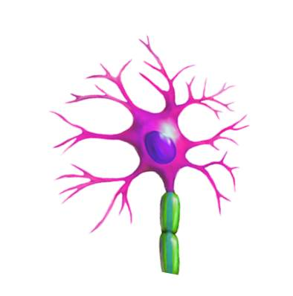

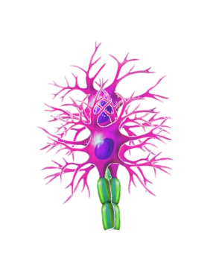
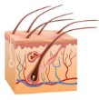
Now let’s study
Types of nerves
Association neurons
Nerves, which conduct impulses from the brain and spinal cord to the effector organs are called as
The integrative functions of nervous system performed by
Sensory neurons conduct impulse from sense organ to spinal cord and brain
Decision making
Sensory neurons
Motor neurons
Afferent nerve
Efferent nerve
Afferent nerve
Efferent nerve
Motor neurons conduct impulse from spinal cord and brain to effector organs like muscles
Nerves, which conduct impulses from the sense organs to the brain and spinal cord are called as
Afferent nerve is made up of sensory neurons
Efferent nerve is made up of motor neurons

Slide 3
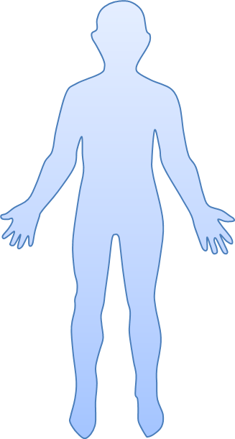

Let’s see all the three neurons working together :
Impulse move from skin to spinal cord and brain through
Association neurons
Then brain decides to move the hand with the help of
Afferent nerve
Efferent nerve
and we are able to move the hand.
So the muscle contracts
This impulse moves from brain and spinal cord to the muscle through
When pin pricks the skin

Slide 4
Let’s see all the three neurons working together :

Slide 5
Thank You

